Slide 1
Community-enhanced De-anonymization of Online Social Networks
Shirin Nilizadeh, Apu Kapadia, Yong-Yeol Ahn
Indiana University Bloomington
CCS 2014

Slide 2





Online Social Networks (OSNs) have revolutionized the way our society communicates
Monthly active users
1.28
Billion
540
million
225
million
187
million
40
million

Slide 3
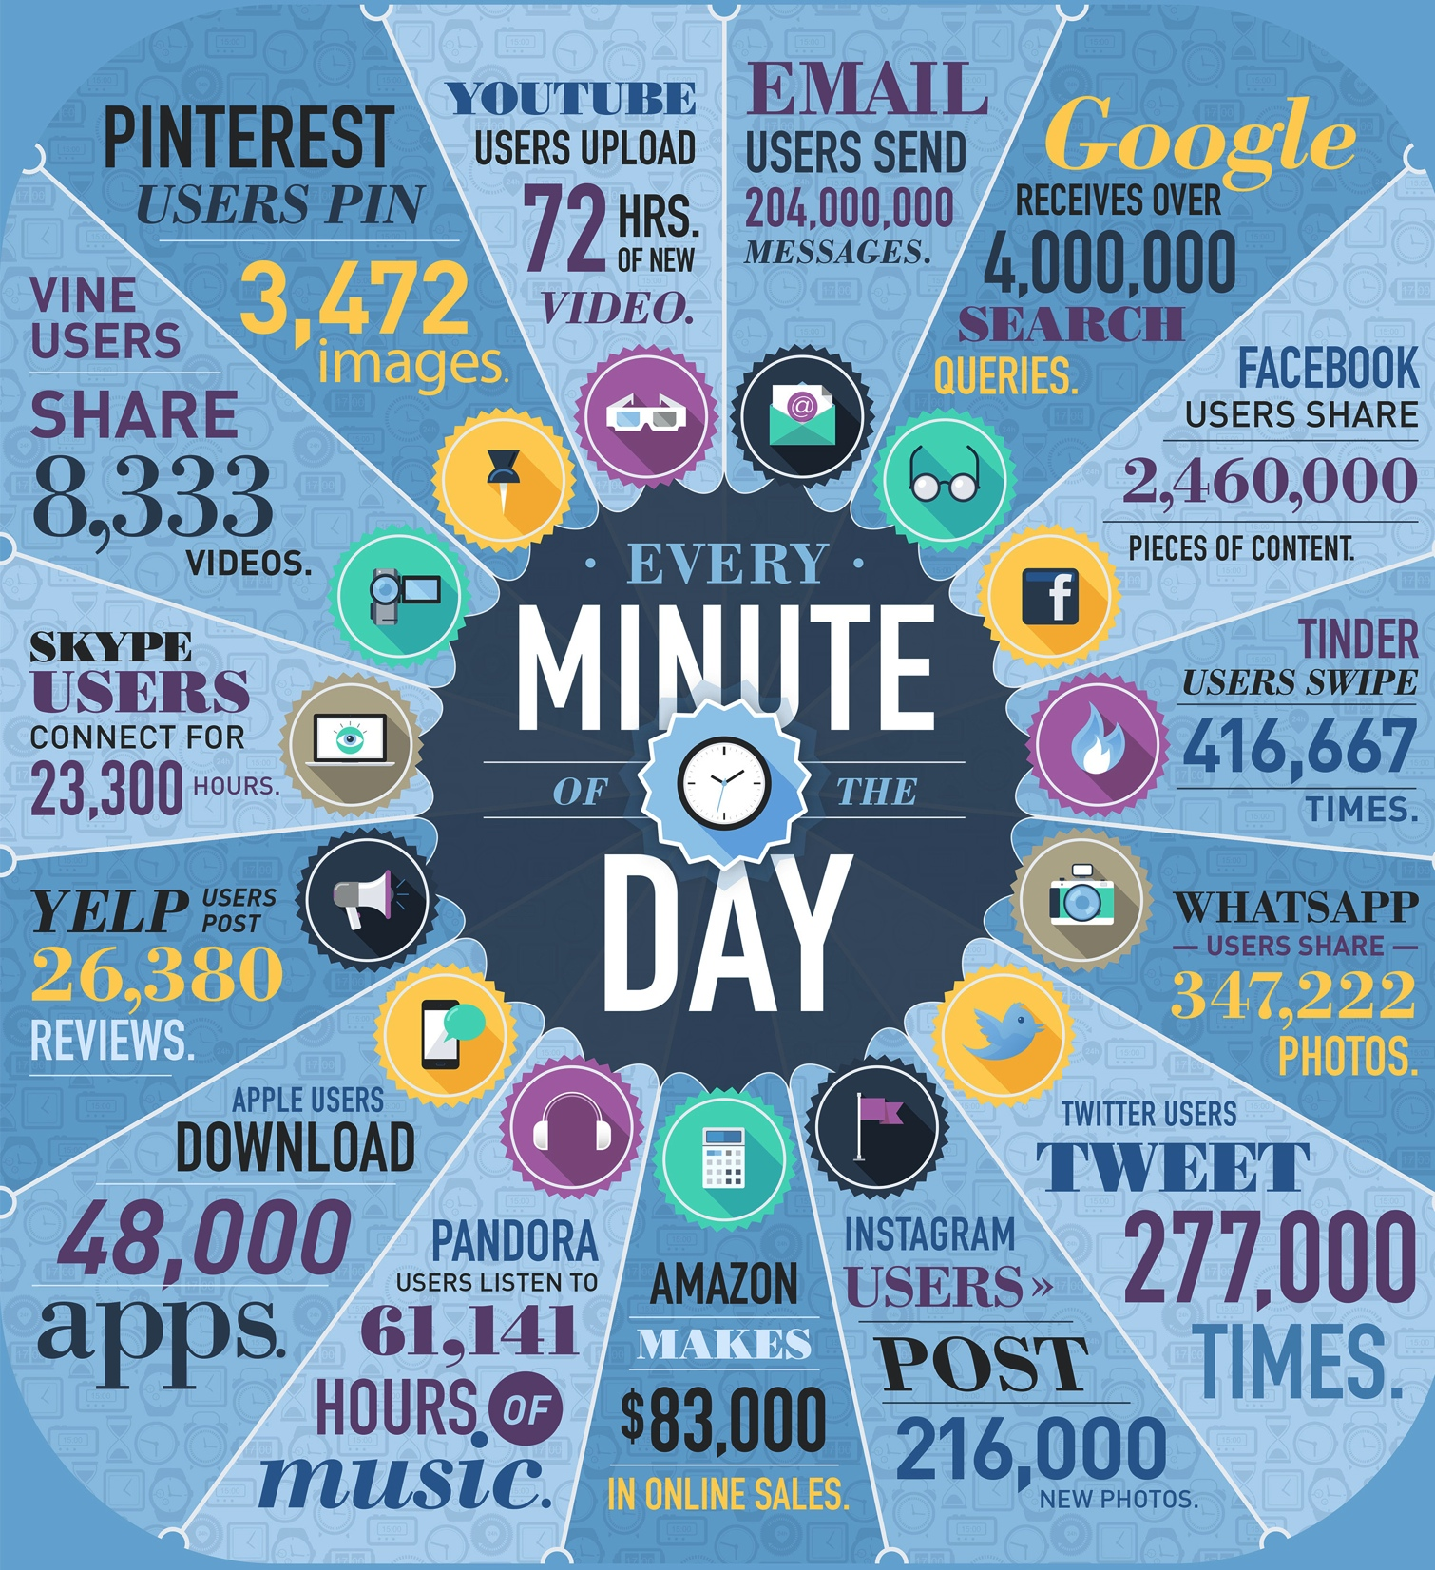
OSN providers have become treasure troves of information for marketers and researchers
Reference: http://www.domo.com/blog/2014/04/data-never-sleeps-2-0/

Slide 4
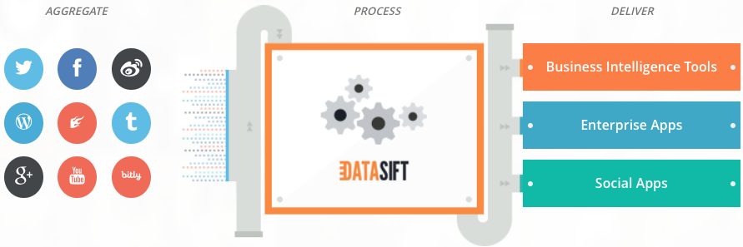
Social Data platforms gather, filter and deliver social data to enterprise-scale companies
Reference: http://datasift.com
Notes:
For example, some social data platforms like datasift and gnip have access to the data of several OSNs and they sell this data in any format that the customer desires. The customers are usually enterprise-scale companies and they use this data for example for getting insights about the market of their product, understanding their audience and even do competitive analysis.

Slide 5




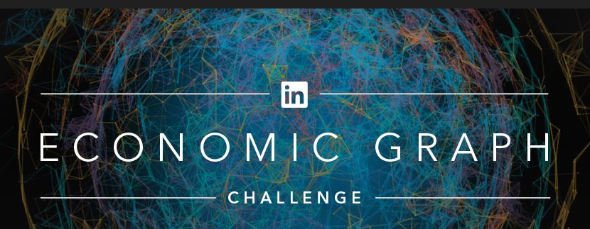
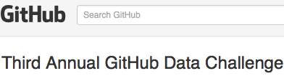
Also, OSN providers publish their ‘anonymized’ social data for competitions and challenges
Notes:
For example, kaggle is a web site for data scientists. It allows individuals or companies to dump their data onto the site, and then Kaggle's 100,000 members create analytical and predictive models based on the data.

Slide 6
Several works have shown that this ‘anonymized’ published data can be de-anonymized

Slide 7
The Kaggle social network challenge: Link prediction on an anonymized dataset

Slide 8
Crawled Flickr and matched users of two public and anonymized Flickr networks
Public Flickr Network
Anonymized Flickr Network
[Narayanan and Shmatikov, 2009]
Notes:
Narayanan and Shmatikov knew that this data has been collected from Flickr website so they also crawled Flickr. Then, they re-identify users in the anonymized dataset using the public crawled dataset. Re-identifing nodes in the anonymized social network, they could see what links are missing and so they report them as their link prediction and actually they won this challenge.

Slide 9
De-anonymizing a social network using another public social network
Flickr Network
Twitter Network
Alice
Republican
Rob
Democrat
Bob
Republican
Carol
Democrat
Eve
Democrat
John
Republican
Notes:
In another attempt, They also show that it is possible to de-anonymize a social network using another public social network when they have similar user sets. They could match users on Flickr dataset to the users on the Twitter dataset.
Please note that re-identifying users in an anonymized social network may reveal sensitive information about the users. For example, if the users in the anonymized Twitter network are attached to their political view. Re-identifying them reveals that information.

Slide 10
Narayanan and Shmatikov’s (NS) de-anonymization approach
Reference Network
Anonymized Network
1- Seed identification
2- Propagation
Notes:
Let’s take a closer look at the NS algorithm. Having a public reference network and an anonymized network, the goal is to re-identify the users in the anonymized social network. Their approach has two steps. The first step is seed identification, By seed, they mean prior knowledge about a few mapping between nodes in anonymized and the reference network. NS proposed an algorithm for finding seeds and a few works also have shown that the possibility of this. Here, I will not explain the methods for finding seeds and we assume that we have this information.
The overall performance of this algorithm can be improved by having more seeds
Step two is propagation. This is an iterative algorithm. It starts from neighbors of seeds and map them if they are sufficiently similar to each other. Similarity is computed based on the local structure of network around the seeds.
In each round, the propagation algorithm considers all mapped nodes in the previous round as seeds and try to match more nodes.

Slide 11
Network communities provide an effective way to divide-and-conquer the problem
Notes:
In this work, we show that we can leverage community structure in the social networks to divide and conquer the problem.
So instead of trying to re-identify nodes in the network, we propose to identify communities of the network first and then zooming in and re-identify nodes inside them.
Communities are more robust to noise thus can be used for de-anonymizing noisier networks and later we show that they are more robust to the number of seeds and also size of network.
Although there is not a unique definition for community in the social network. In this work, we define communities as groups of nodes (people) that are densely connected to each other while having less connections outside of the community

Slide 12
Comm-aware vs. Comm-blind
Notes:
Any existing community-blind mapping algorithm such as NS algorithm can be used to map communities and then the entire network. Thus, we call our approach as community-aware in contrast to comm-blind approaches.

Slide 13
Step 1- Community Detection: slicing the network into smaller, dense chunks
Reference Network
Anonymized Network
Notes:
In the first step, we slice both reference and anonymized networks into smaller, dense chunks using any community detection algorithm. There exist, a large number of community detection methods. In our experiments, we employed Infomap algorithm because it is one of the most widely accepted community detection algorithm
Note that these partitions may not correspond to meaningful social groups

Slide 14
Step 2- Creating graph of communities and mapping communities
Reference Network
Anonymized Network
Notes:
The next step is to create graph of communities. We put a link between two communities if at least one node from the first community is connected to a node in another community.
As you can see in our example, there might be more than one link between two communities. In that case, we can have a weighted graph of communities.
After generating this graph for both reference and anonymized networks, we try to map communities. To map communities, we can use NS algorithm on the graph of communities. Since this graph is weighted, we improved the similarity measure proposed by Narayanan and Shmatiko to include edges’ weights. I will not explain this improved measure but you can find it in the paper.
To run NS algorithm on the graph, we need a few community seeds. We assume that we know a few mapped nodes, so we can map their communities and consider those communities as seeds in the graph of communities.

Slide 15
Step 3- Seed enrichment and local propagation
Identifying more seeds using nodes’ degrees and clustering coefficients
Notes:
After mapping communities in the graph of communities, we get to the seed enrichment step which means we try to find more seeds in the mapped communities. We defined two similarity metrics based on nodes’ degrees and clustering coefficients and match two nodes if they are similar enough. In our experiments, we found out that having more seeds, increases the precision.
Identifying some nodes as seeds inside communities, we can employ community-blind algorithm inside two communities as smaller sub-graphs. Partitioning the networks makes running parallel processes possible which is a nice feature if we are dealing with a huge social network.

Slide 16
Step 4- Global propagation further extends the mapping
Reference Network
Anonymized Network
Notes:
If some communities and thus their nodes are not mapped, we can employ the comm-blind algorithm on the entire network where the algorithm gets all the already mapped nodes as seeds.

Slide 17
We tested our approach on real-world datasets
Real-world data set | Number of Nodes | Number of edges
arXiv collaboration network | 36,458 | 171,735
Twitter mention network 1 | 90,332 | 377,588
Twitter mention network 2 | 9,745 | 50,164
Used the METIS graph partitioning algorithm to obtain a smaller network

Slide 18
Generating noisy anonymized networks with same set of nodes and different but overlapping set of edges
- Noise level:
{0.1%, 1%, 5%, 10%, 15%, 20%, 30%, 40%}
- Generated an ensemble of 10 networks for each network
Notes:
Since we didn’t have access to two social network with the same or overlapping nodes and edges, we had to generate the noisy anonymized version of the social networks and try to map the original graph with the noisy anonymized one. Using this technique, we had the ground truth and could evaluate the approaches.
Here I show how we generated anonymized network with the same set of nodes and different but overlapping set of edges. We generated noisy graphs with different levels of noises. For each level of noise, we randomly deleted and added edges to the network. For each noise level, we generated an ensemble of 10 networks for each of the real-world networks. The results show the average performance of running de-anonymization algorithms on these networks.
We also generated noisy networks with different sets of nodes and edges and employ de-anonymization algorithms on them. However, I will not explain them and you can find them in the paper.
.

Slide 19
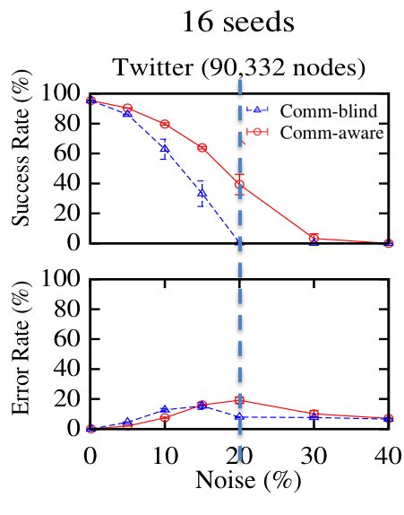
Measuring performance using success rate and error rate
With 20% edge noise and 16 seeds, the NS maps can barely maps any node while,
our approach maps 40% of the nodes

Slide 20
Need to consider information gain: degree of anonymity
In practice, the mapping algorithm may still leave several nodes unmapped. For these unmapped nodes, however, the community structure reveals information about the true mapping

Slide 21
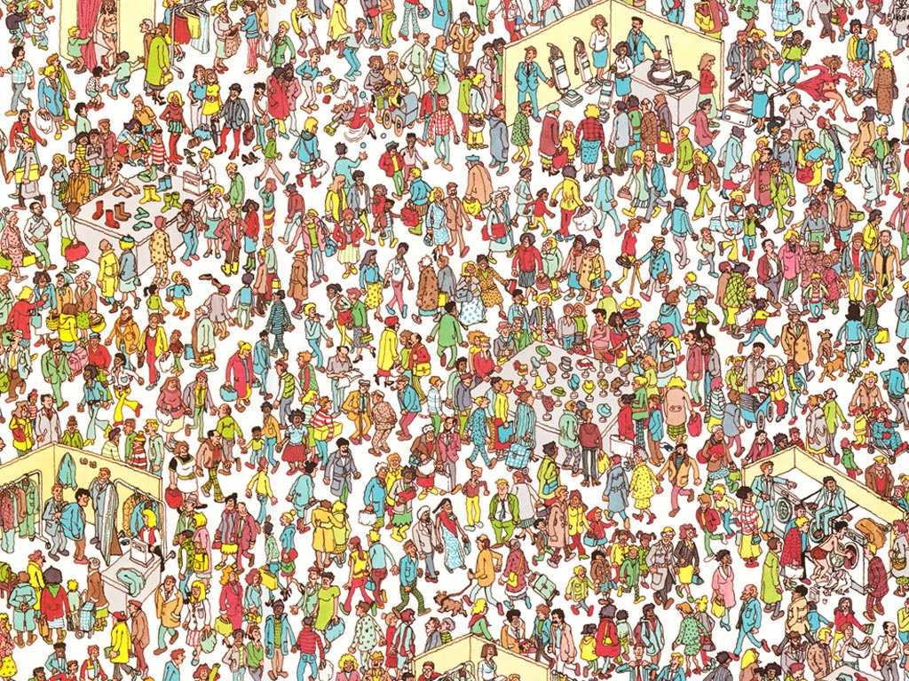

What is the degree of anonymity for Waldo?
Notes:
Where is Waldo is a series of children's books which shows a large number of people engaged in all sorts of activities. Readers are challenged to find a character named Waldo hidden in the group.
Not knowing where the Waldo is, the probability that Waldo being mapped to any person in the picture is 1/n where n is the number of people in the picture. Calculating the entropy over these probabilities, we get the max entropy and the degree of anonymity for Waldo would be 1.

Slide 22
Degree of anonymity for Wlado degrades knowing that he loves socks!
Notes:
However, if one knows that Waldo loves socks and he is with higher probability close to the table of socks and with lower probability in other places, then he would start searching from that location. Thus, the entropy over these various probabilities is less than the max entropy and the degree of anonymity for the Waldo degrades.

Slide 23
Calculating degree of anonymity
The anonymity for a user u is the entropy over the probability distribution of potential mappings being true for user u:
The normalized degree of anonymity for user u:
The degree of anonymity for the whole system:

Slide 24
Calculating degree of anonymity: Case 1
Comm-blind
Comm-aware
0.01
0.01
0.037
0.003
0.8
0.01
0.01
0.8
0.037
0.003
0.01
0.003
0.01
0.003
0.01
0.01
0.037
0.003
0.01
0.037
0.003
0.01
0.01
0.01
0.003
0.003
0.003
0.01
0.01
0.003
0.01
0.01
0.003
0.003
0.01
0.003
Notes:
We ran extensive simulations for each network and using the ground truth we could derive the probability distribution for a user being correctly or incorrectly mapped to any node in the anonymized network. For example, if two black nodes in two networks are mapped by the comm-blind algorithm, and we know that with probability 80% this is a true mapping, then the probability that this node being mapped to any other node in the network is 20% divide by the number of nodes in the network minus 1. Using this probability distribution, we can compute the entropy and the degree of anonymity.
Then, again, if knowing that the two black nodes and their communities are mapped by the community-aware algorithm, and we know that with probability 80% this is a true mapping, and with some probability this node can be mapped to other nodes inside the community. Then, knowing with what probability it is possible that the true mapping for the node is outside the community, we can compute the degree of anonymity.
This is only the first case for each algorithm. We have shown how we can compute degree of anonymity for other cases when for example, the node is not mapped but it’s community has mapped or when both the node and its community has not mapped. In tocal for comm aware algorithm we has 5 cases.
Note that this calcualtion is not precise and one can put more constraints on calcualting the probabilities. We had a more complex calculatiion with 26 cases but we didn’t that much difference in the degree of anonymity. Our calcualtion shows the upperbound on the degree of anonymity.

Slide 25
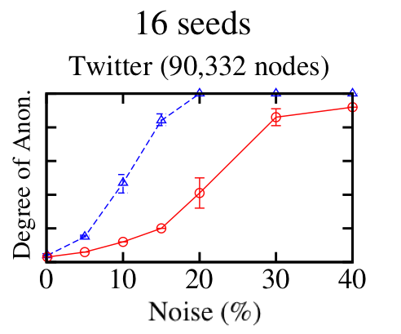
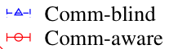
Community-aware algorithm greatly improves de-anonymization performance under noise
With 15% edge noise and 16 seeds, the comm-blind technique reduces anonymity by 2.6 bits, whereas our approach reduces anonymity by 13.17 bits

Slide 26
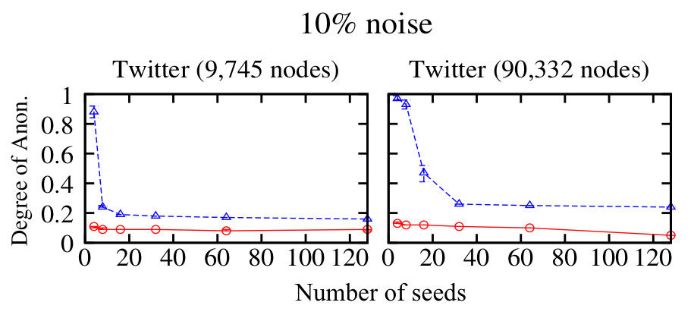
Community-aware algorithm is more robust to larger network size and a low number of seeds
For the Twitter dataset with 90K nodes, with 10% edge noise and only 4 seeds, the comm-blind technique reduces anonymity by 2.14 bits, whereas our approach reduces anonymity by 15.97 bits

Slide 27
Limitations
We didn’t have access to two real-world social network data sets with the overlapping sets of users and edges
Our measure is estimating the upper bound of the degree of anonymity
We approximate the real probabilities for calculating degree of anonymity by running simulations

Slide 28
Future work
Advanced anonymization techniques are required
Our approach can be improved by use of additional attributes for re-identifying communities and users
Test other anonymization techniques using comm-aware de-anonymization approach

Slide 29
Conclusion
Our approach divides the problem into smaller sub-problems that can be solved by leveraging existing network alignment methods recursively on multiple levels
Our approach is more robust against added noise to the anonymized data set, and can perform well with fewer known seeds as well as larger networks.
We analyzed the ‘degree of anonymity’ of users in the graph and showed that the mapping of communities may markedly reduce the degree of anonymity of users.

Slide 30
Contact: Shirnili@indiana.edu
THANK YOU!
QUESTIONS?

